Slide 1
Supermarket Billing System

Slide 2
INTERODUCTION
Supermarket is the place where customers come to purchase their daily using products and pay for that .There is a need to calculate how many products are for the customer. In our project and implement we have 3 users. Frist is the data entry operator who will enter the product in database. Second one is the administrator on the products and can see the report of any product. Third one is the bill calculating operator who will calculate the bill and print …

Slide 3
WORK FLOW
WORK IN THE SUPER MARKET WILL BE DONE IN THE FOLLOWING WAY :
The product will come in the store .
Data entry operator will enter the information of the product in database .
The administrator will enter the taxes and commissions for each product .
The customer will come and take the basket with him /her and choose the product and took it to the counter.
The bill calculating operator will check the products with the bar code detecting machine then it will math with product –id then it will show its information and price and the bill will be calculated and total payment will shown.
Customer will pay for the products.
All the products will be packed and delivered to the customer.

Slide 4
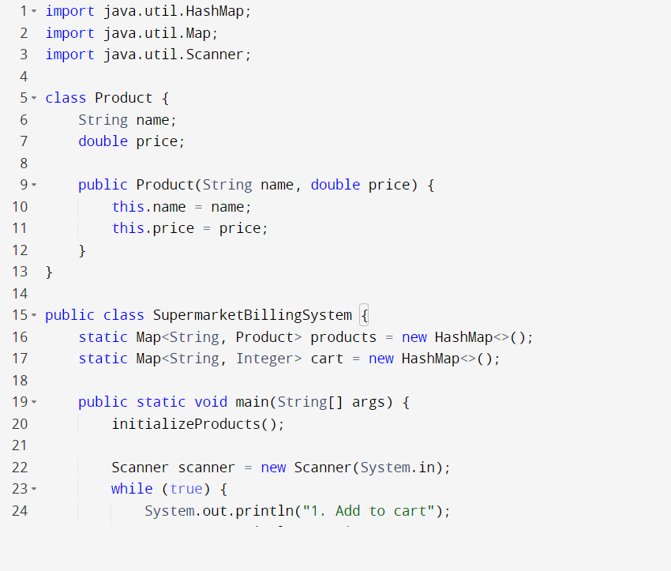

Slide 5
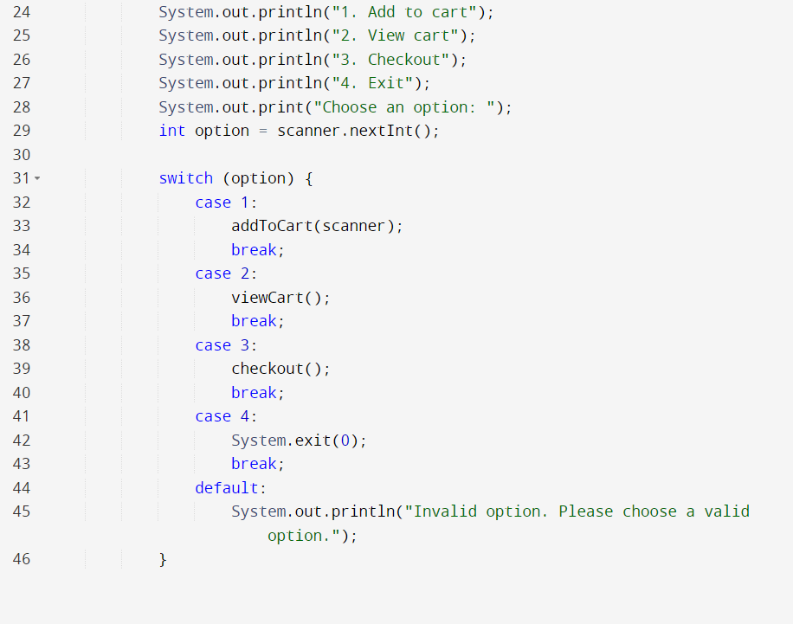

Slide 6
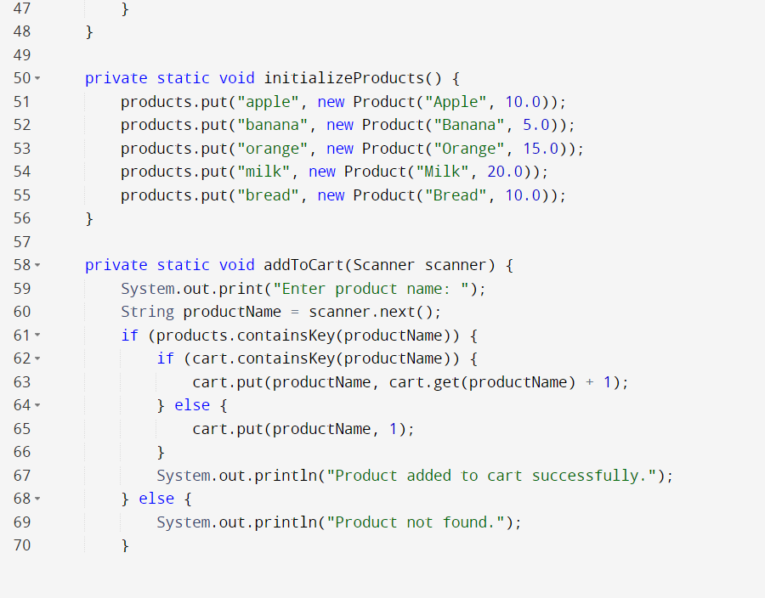

Slide 7
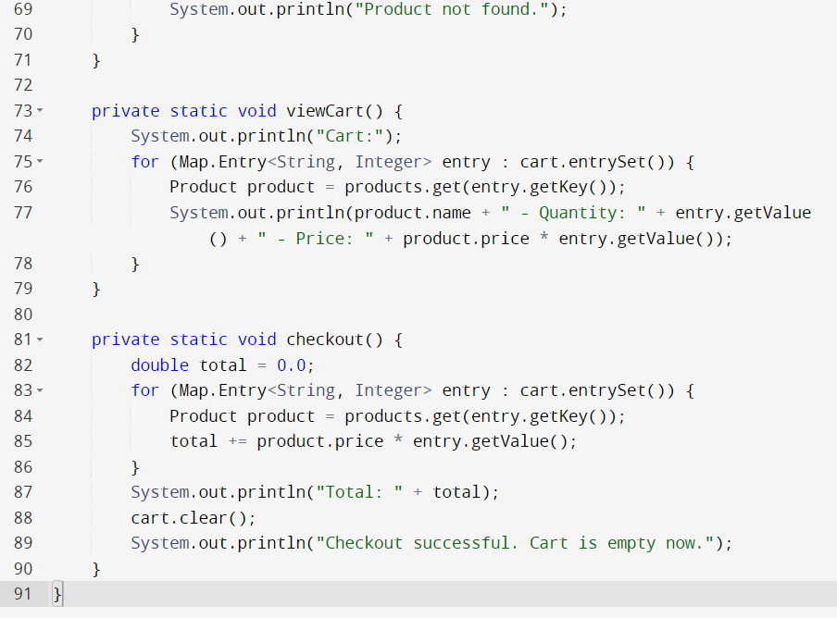

Slide 8
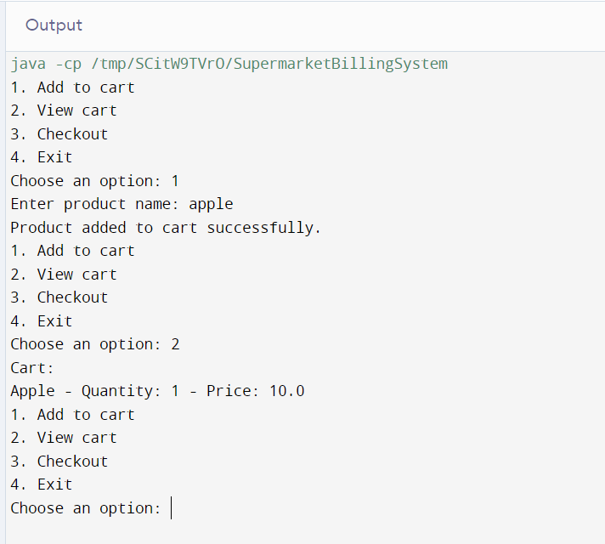

Slide 9
LIMITATION
There is lack of personal attention.
It require large and extensive premises.
Goods which require explanation by salesman cannot be sold in such markets.

Slide 10
CONCLUSION
Our project and implementation is on supermarket billing system .We have successfully completed it . We take this opportunity to express our sense of indebtedness and gratitude to all those people who helped us in completing this project and implementation .
This project and implementation has contributed a lot to our knowledge that has proved to be a value addition for us .

Slide 11


